Slide 1

Chapter 2
Application Layer
A note on the use of these PowerPoint slides:
We’re making these slides freely available to all (faculty, students, readers). They’re in PowerPoint form so you see the animations; and can add, modify, and delete slides (including this one) and slide content to suit your needs. They obviously represent a lot of work on our part. In return for use, we only ask the following:
If you use these slides (e.g., in a class) that you mention their source (after all, we’d like people to use our book!)
If you post any slides on a www site, that you note that they are adapted from (or perhaps identical to) our slides, and note our copyright of this material.
For a revision history, see the slide note for this page.
Thanks and enjoy! JFK/KWR
All material copyright 1996-2020
J.F Kurose and K.W. Ross, All Rights Reserved
Computer Networking: A Top-Down Approach
8th edition n
Jim Kurose, Keith Ross
Pearson, 2020
Notes:
Version History
8.1. Updates throughout, including a lot more animations. These are the ppt files used to make Chapter 2 online lectures in Sept. 2020.
8.0 (April 2020)
All slides reformatted for 16:9 aspect ratio
All slides updated to 8th edition material
Use of Calibri font, rather that Gill Sans MT
Add LOTS more animation throughout

Slide 2

Application layer: overview
An application layer is an abstraction layer that specifies the shared communications protocols and interface methods used by hosts in a communications network. An application layer abstraction is specified in both the Internet Protocol Suite (TCP/IP) and the OSI model
Principles of network applications
Web and HTTP
E-mail, SMTP, IMAP
The Domain Name System DNS
P2P applications
video streaming and content distribution networks
socket programming with UDP and TCP

Slide 3
Application layer: overview
Our goals:
conceptual and implementation aspects of application-layer protocols
  transport-layer service models
  client-server paradigm
  peer-to-peer paradigm
learn about protocols by examining popular application-layer protocols and infrastructure
  HTTP
  SMTP, IMAP
  DNS
  video streaming systems, CDNs
programming network applications
  socket API

Slide 4
Some network apps
social networking
Web
text messaging
e-mail
multi-user network games
streaming stored video (YouTube, Hulu, Netflix)
P2P file sharing
voice over IP (e.g., Skype)
real-time video conferencing (e.g., Zoom)
Internet search
remote login
…
Q: your favorites?

Slide 5
















Creating a network app
application
transport
network
data link
physical
write programs that:
run on (different) end systems
communicate over network
e.g., web server software communicates with browser software
no need to write software for network-core devices
network-core devices do not run user applications
applications on end systems allows for rapid app development, propagation
mobile network
national or global ISP
local or regional ISP
home network
content
provider
network
application
transport
network
data link
physical
application
transport
network
data link
physical
datacenter
network
enterprise
network

Slide 6
Network application architecture
client-server architecture
P2P architecture

Slide 7
Client-server paradigm
server:
always-on host which services requests from many other hosts, called clients
permanent IP address
often in data centers, for scaling
clients:
always-on host which make the requests or contact, communicate with server
may be intermittently connected
may have dynamic IP addresses
do not communicate directly with each other
examples: HTTP, IMAP, FTP
mobile network
national or global ISP
local or regional ISP
home network
content
provider
network
datacenter
network
enterprise
network

Slide 8

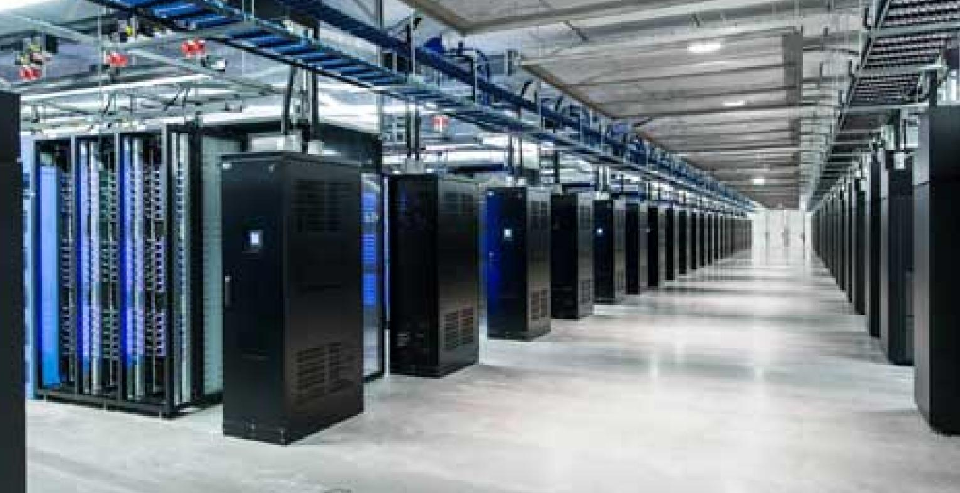
data center
  A data center, housing a large number of hosts, is often used to create a powerful virtual server.
  The most popular Internet services—such as
    search engines (e.g., Google and Bing),
    Internet commerce (e.g., Amazon and e-Bay),
    Web-based email (e.g., Gmail and Yahoo Mail),
    social networking (e.g., Facebook and Twitter)— employ one or more data centers.
Meta data center
Facebook data center(swedon)

Slide 9
Peer-peer architecture
no always-on server
Peer
  direct communication between pairs of intermittently connected hosts, called peers
peers request service from other peers, provide service in return to other peers
  self scalability – new peers bring new service capacity, as well as new service demands
peers are intermittently connected and change IP addresses
  complex management
example: P2P file sharing
most of the peers residing in homes, universities, and offices
mobile network
national or global ISP
local or regional ISP
home network
content
provider
network
datacenter
network
enterprise
network

Slide 10
Processes communicating
process: program running within a host
within same host, two processes communicate using inter-process communication (defined by OS)
processes in different hosts communicate by exchanging messages
clients, servers
client process: process that initiates communication
server process: process that waits to be contacted
note: applications with P2P architectures have client processes & server processes

Slide 11

Sockets
A process sends messages into, and receives messages from, the network through a software interface called a socket
socket analogous to door
  sending process shoves message out door
  sending process relies on transport infrastructure on other side of door to deliver message to socket at receiving process
  two sockets involved: one on each side
application
socket
application
controlled by
app developer
process
process
transport
transport
network
network
controlled
by OS
link
Internet
link
physical
physical

Slide 12
Addressing processes
to receive messages, process must have identifier
an IP
address is a 32-bit quantity that we can think of as uniquely identifying the host
Q: does IP address of host on which process runs suffice for identifying the process?
identifier includes both IP address and port numbers associated with process on host.
example port numbers:
  HTTP server: 80
  mail server: 25
to send HTTP message to www.ritrjpm.ac.in web server:
  IP address: 128.119.245.12
  port number: 80
  A: no, many processes can be running on same host

Slide 13
An application-layer protocol defines:
types of messages exchanged,
  e.g., request, response
message syntax:
  what fields in messages & how fields are delineated
message semantics
  meaning of information in fields
rules for when and how processes send & respond to messages
open protocols:
defined in RFCs, everyone has access to protocol definition
allows for interoperability
e.g., HTTP, SMTP
proprietary protocols:
e.g., Skype, Zoom

Slide 14
What transport service does an app need?
throughput
The application could request a guaranteed throughput of r bits/sec, and the transport protocol would then ensure that the available throughput is always at least r bits/sec
some apps (e.g., multimedia) require minimum amount of throughput to be “effective”
other apps (“elastic apps”) make use of whatever throughput they get
data integrity
some apps (e.g., file transfer, web transactions) require 100% reliable data transfer
other apps (e.g., audio) can tolerate some loss
timing
some apps (e.g., Internet telephony, interactive games) require low delay to be “effective”
security
encryption, data integrity, …

Slide 15
Transport service requirements: common apps
application
file transfer/download
e-mail
Web documents
real-time audio/video
streaming audio/video
interactive games
text messaging
data loss
no loss
no loss
no loss
loss-tolerant
loss-tolerant
loss-tolerant
no loss
throughput
elastic
elastic
elastic
audio: 5Kbps-1Mbps
video:10Kbps-5Mbps
same as above
Kbps+
elastic
time sensitive?
no
no
no
yes, 10’s msec
yes, few secs
yes, 10’s msec
yes and no

Slide 16
Internet transport protocols services
TCP service:
reliable transport between sending and receiving process
flow control: sender won’t overwhelm receiver
congestion control: throttle sender when network overloaded
connection-oriented: setup required between client and server processes
does not provide: timing, minimum throughput guarantee, security
UDP service:
unreliable data transfer between sending and receiving process
does not provide: reliability, flow control, congestion control, timing, throughput guarantee, security, or connection setup.
Q: why bother? Why is there a UDP?

Slide 17
Internet applications, and transport protocols
application
layer protocol
FTP [RFC 959]
SMTP [RFC 5321]
HTTP 1.1 [RFC 7320]
SIP [RFC 3261], RTP [RFC 3550], or proprietary HTTP [RFC 7320], DASH
WOW, FPS (proprietary)
application
file transfer/download
e-mail
Web documents
Internet telephony
streaming audio/video
interactive games
transport protocol
TCP
TCP
TCP
TCP or UDP
TCP
UDP or TCP

Slide 18
Securing TCP
Vanilla TCP & UDP sockets:
no encryption
cleartext passwords sent into socket traverse Internet in cleartext (!)
Transport Layer Security (TLS)
provides encrypted TCP connections
data integrity
end-point authentication
TSL implemented in application layer
apps use TSL libraries, that use TCP in turn
  cleartext sent into “socket” traverse Internet encrypted
  more: Chapter 8

Slide 19
Socket programming
goal: learn how to build client/server applications that communicate using sockets
socket: door between application process and end-end-transport protocol
application
socket
application
controlled by
app developer
process
process
transport
transport
network
network
controlled
by OS
link
Internet
link
physical
physical

Slide 20
Socket programming
  Two socket types for two transport services:
  UDP: unreliable datagram
  TCP: reliable, byte stream-oriented
  Application Example:
client reads a line of characters (data) from its keyboard and sends data to server
server receives the data and converts characters to uppercase
server sends modified data to client
client receives modified data and displays line on its screen

Slide 21
Socket programming with UDP
User Datagram Protocol (UDP) is a communications protocol that is primarily used to establish low-latency and loss-tolerating connections between applications on the internet.
UDP: no “connection” between client and server:
no handshaking before sending data
sender explicitly attaches IP destination address and port # to each packet
receiver extracts sender IP address and port# from received packet
UDP: transmitted data may be lost or received out-of-order
Application viewpoint:
UDP provides unreliable transfer of groups of bytes (“datagrams”) between client and server processes

Slide 22
Client/server socket interaction: UDP
server (running on serverIP)
client
create socket:
create socket, port= x:
clientSocket =
socket(AF_INET,SOCK_DGRAM)
serverSocket =
socket(AF_INET,SOCK_DGRAM)
Create datagram with serverIP address
And port=x; send datagram via
clientSocket
read datagram from
serverSocket
write reply to
serverSocket
specifying
client address,
port number
read datagram from
clientSocket
close
clientSocket

Slide 23
Example app: UDP client
Python UDPClient
include Python’s socket library
from socket import *
serverName = ‘hostname’
serverPort = 12000
clientSocket = socket(AF_INET, SOCK_DGRAM)
message = raw_input(’Input lowercase sentence:’)
clientSocket.sendto(message.encode(),
(serverName, serverPort))
modifiedMessage, serverAddress =
clientSocket.recvfrom(2048)
print modifiedMessage.decode()
clientSocket.close()
create UDP socket for server
get user keyboard input
attach server name, port to message; send into socket
read reply characters from socket into string
print out received string and close socket

Slide 24
Example app: UDP server
Python UDPServer
from socket import *
serverPort = 12000
serverSocket = socket(AF_INET, SOCK_DGRAM)
serverSocket.bind(('', serverPort))
print (“The server is ready to receive”)
while True:
message, clientAddress = serverSocket.recvfrom(2048)
modifiedMessage = message.decode().upper()
serverSocket.sendto(modifiedMessage.encode(),
clientAddress)
create UDP socket
bind socket to local port number 12000
loop forever
Read from UDP socket into message, getting client’s address (client IP and port)
send upper case string back to this client

Slide 25
Socket programming with TCP
Transmission Control Protocol (TCP) is a communications standard that enables application programs and computing devices to exchange messages over a network
Client must contact server
server process must first be running
server must have created socket (door) that welcomes client’s contact
Client contacts server by:
Creating TCP socket, specifying IP address, port number of server process
when client creates socket: client TCP establishes connection to server TCP
when contacted by client, server TCP creates new socket for server process to communicate with that particular client
  allows server to talk with multiple clients
  source port numbers used to distinguish clients (more in Chap 3)
Application viewpoint
TCP provides reliable, in-order
byte-stream transfer (“pipe”)
between client and server processes

Slide 26
Client/server socket interaction: TCP
server (running on hostid)
client
create socket,
port=x, for incoming request:
serverSocket = socket()
wait for incoming
connection request
TCP
connection setup
create socket,
connect to hostid, port=x
connectionSocket =
serverSocket.accept()
clientSocket = socket()
send request using
clientSocket
read request from
connectionSocket
write reply to
connectionSocket
read reply from
clientSocket
close
connectionSocket
close
clientSocket

Slide 27
Example app: TCP client
Python TCPClient
from socket import *
serverName = ’servername’
serverPort = 12000
clientSocket = socket(AF_INET, SOCK_STREAM)
clientSocket.connect((serverName,serverPort))
sentence = raw_input(‘Input lowercase sentence:’)
clientSocket.send(sentence.encode())
modifiedSentence = clientSocket.recv(1024)
print (‘From Server:’, modifiedSentence.decode())
clientSocket.close()
create TCP socket for server, remote port 12000
No need to attach server name, port

Slide 28
Example app: TCP server
Python TCPServer
from socket import *
serverPort = 12000
serverSocket = socket(AF_INET,SOCK_STREAM)
serverSocket.bind((‘’,serverPort))
serverSocket.listen(1)
print ‘The server is ready to receive’
while True:
connectionSocket, addr = serverSocket.accept()
sentence = connectionSocket.recv(1024).decode()
capitalizedSentence = sentence.upper()
connectionSocket.send(capitalizedSentence.
encode())
connectionSocket.close()
create TCP welcoming socket
server begins listening for incoming TCP requests
loop forever
server waits on accept() for incoming requests, new socket created on return
read bytes from socket (but not address as in UDP)
close connection to this client (but not welcoming socket)

